Slide 1
Moving the Needle on Post-Hospitalization Morbidity: Predicting 30-day Readmissions LACE Index model
Presented by:
Noellee Clarke, MD & Jason Schaffer, MD

Slide 2
Reason for Action
Need to Decrease 30 Day Readmissions
30 day readmissions are a significant cost
Direct Costs: $41.3 billion dollars in 2011
Non-Reimbursed Care
Resource Utilization
Indirect Costs
HEDIS and Quality Measures
Impact Brand/Hospital Image
Significant patient morbidity
Notes:
$41.3 billion over 11 months 2011 to treat patients readmitted within 30 days of DC
1.8 million readmissions cost the Medicare program $24 billion
600,000 privately insured patient readmissions totaled $8.1 billion
700,000 Medicaid patient readmissions cost hospitals $7.6 billion
2% Medicare fines
We are competing with other hospitals and we want our patients to get great care then go home and stay home
Healthcare is now a consumer driven our patients and their family are the consumers, we need to do better for them and our business.

Slide 3
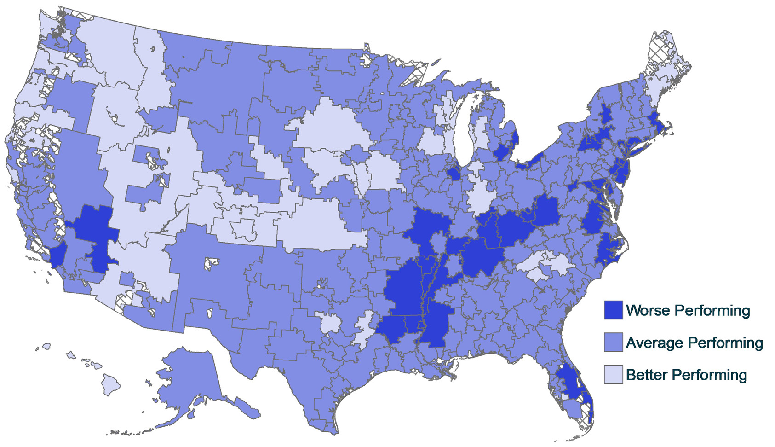
How Are We Doing?
CMS Hospital Quality Chartbook 2014
Source Data and Population: Hospital-Wide Readmission Measure Cohort data,
July 2012 – June 2013
Notes:
Our hospital readmission rate is 18
Hospital-Wide RSRR (%)
Maximum 21.4
90% 16.8
75% 16.1
Median (50%) 15.5
25% 15.1
10% 14.5
Minimum 11.0

Slide 4
LACE Index Predictive Model
Predicting readmission based on 4 key components
Length of Stay
Acuity of Admission
Charleson comorbidity index
ED visits 6 months prior to admission
Previously validated in Ontario Canada
Can it be applied to our population?

Slide 5
Validation & Application to Our Population
Neuropsychiatric Unit
High readmission rates and high morbidity
Population
10k patients, 34.5k encounters
Comorbidities
Cerebrovascular Accident
Dementia

Slide 6
Model Analysis L+A+C+E
Analysis
Logistic regression model
Models Tested
LACE Score
L, A, C, E Components
LACE Score
Predictive Probability Threshold: 0.35
95% CI : (0.8356, 0.8528)
Negative Predictive Value: 99.4%
Model Accuracy: 0.8443
AUC = 0.644
L + A + C + E
Predictive Probability Threshold: 0.35
95% CI : (0.8356, 0.8528)
Negative Predictive Value: 98.4%
Model Accuracy: 0.8443
AUC = 0.676

Slide 7
LACE Distribution by Percentage

Slide 8
Percent of Readmissions per LACE Score

Slide 9
Apply Theory to Clinical Practice
Clinical Decision Support in real time
Support clinicians and ancillary staff
Leverage current EHR features
Reinforce best practices
Daily recalculation to project risk prior to D/C
Monitoring & Maintaining Success
6 month pilot with 3 month assessment of ROI
Dashboard 30 day readmission rate
Model reevaluation as our population changes

Slide 10
Move Toward Meaningful Change
Our charge to you
Resources to dedicate to this high risk group
Prospective Pilot of the model and prediction tool
Champions for change

Slide 11
Thank you!

